Slide 1

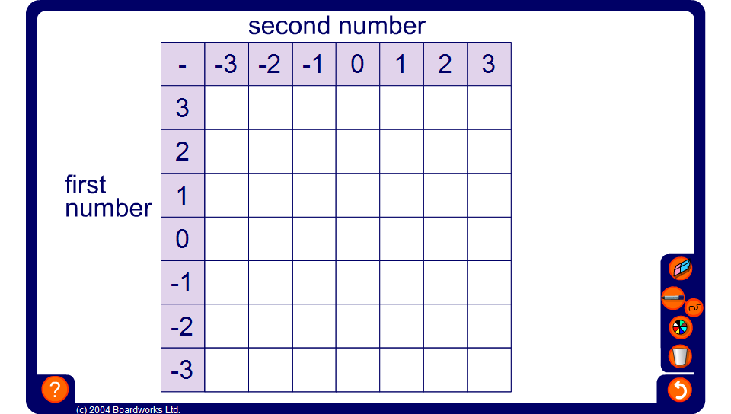


Ordered subtraction square
Notes:
This ordered subtraction square can be used to draw the pupils’ attention to the number patterns produced when subtracting positive and negative integers in order.
Point out that we are subtracting the integers across the top from the integers down the side.
Clicking on a cell will reveal the number inside it.
Start by revealing the cells on the far right and moving in order along the row to the left. Alternatively, make the activity more difficult by revealing the cells in random order.
Once the table is complete, ask pupils to use it to answer some given questions.
For example,
Use the table to work out –1 – –3.

